Slide 1
Milestone 3 & Final Presentaion
[INST737] Digging into Data
Makoto Asami & Pulkit Kaushal

Slide 2
Research Question
・How people’s online activities such as “tweeting” relate to their countries’ various indices such as GDP per capita or unemployment rate?
・We examined how countries’ indices help predict sentiments of tweets made in the countries.

Slide 3
Collecting Tweets from each country
・A Python code collected 1000 tweets from each of 214 countries and regions.
・Recent, English tweets with location information
Tweets with location information
・Tweets which have geolocation (latitude & longitude)
・Tweets’ whose user accounts have location registered

Slide 4
Sentiment Analysis
・R code to analyze tweet’s sentiment by counting number of ‘positive’ words and ‘negative’ words
・Calculated average per country and made it as the country’s sentiment score
・Aligned with other indices of 2012 obtained from World Bank and compared (tweets data: 2014)

Slide 5
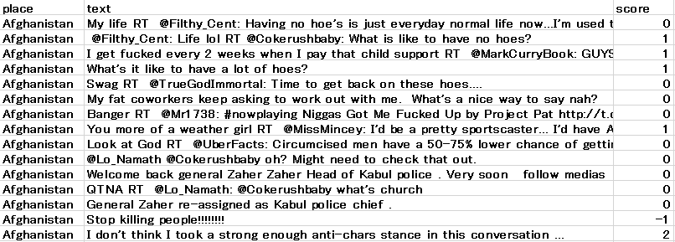
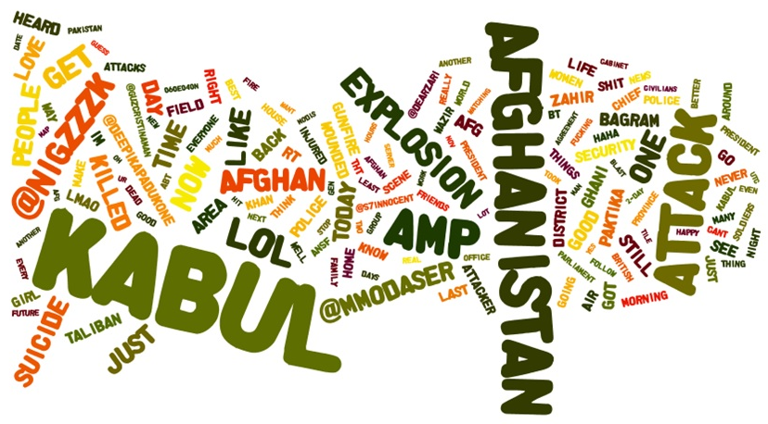

Slide 6
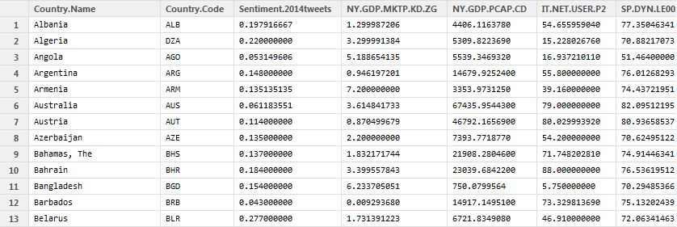
Combined with World Bank data

Slide 7
SVM : Support Vector Machines
SVM’s helps us in classification and regression analysis
Linear SVM:
Non- Linear SVM
Multi class SVM

Slide 8
Linear SVM
Data Manipulation
Classifier: Categorical Variable : high
Conducted Confusion Matrix
used KSVM and kernel = Vanilladot
Average Accuracy = 0.776

Slide 9
Non- Linear SVM
Same steps as in Linear SVM
Changed kernel from vanilladot to rbfdot
Result: Average Accuracy: 0.736

Slide 10
Multi Class SVM
used e1071 and caret packages
used 3 valued categorical variable “Category”
Result: 0.70

Slide 11
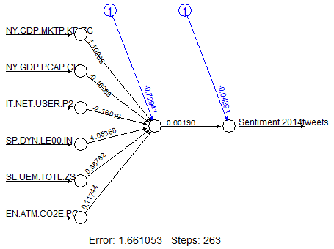
Neural Network
GDP growth (annual %)
GDP per capita (current US$)
Internet users (per 100 people)
Life expectancy at birth, total (years)
Unemployment, total (% of total labor force)
CO2 emissions (metric tons per capita)
↓
Tweets' sentiment
Correlation:
-0.002768198211

Slide 12
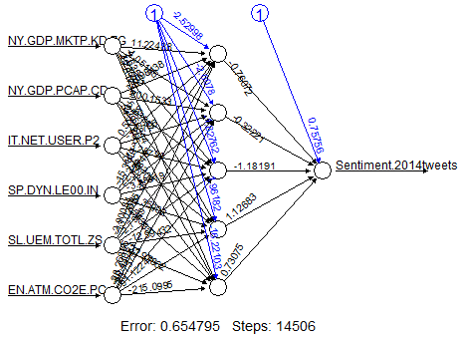
Neural Network (with 5 hidden nodes)
Correlation:
-0.01986744919
(※ slight improvement
from -0.002768198211
but still very weak.)

Slide 13
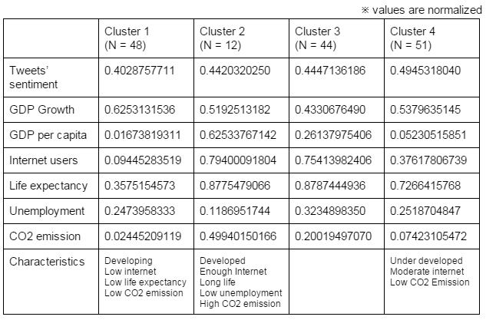
Clustering (k-means)

Slide 14
Comparative Analysis
Used klaR and Caret Packages
compared SVM, Naive Bayes and random Forest classifiers
Created boxplot and dotplot

Slide 15
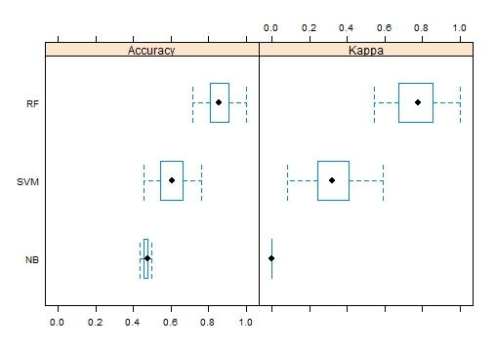
Comparative Analysis
Boxplot:
Suggests that
RF is the Best
Fit

Slide 16
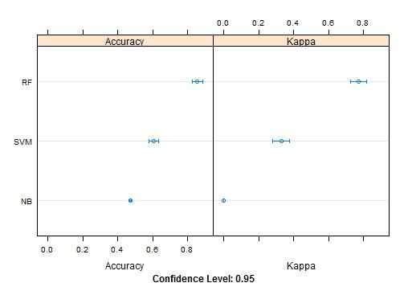
Comparative Analysis
Dotplot:
Suggests that
RF is the
Best Fit

Slide 17
Comparative Analysis
Results:
Accuracy
Min. 1st Qu. Median Mean 3rd Qu. Max. NA's
NB 0.4348 0.4600 0.4762 0.4721 0.4762 0.5000 0
RF 0.7143 0.8095 0.8571 0.8567 0.9080 1.0000 0
SVM 0.4545 0.5519 0.6050 0.6061 0.6591 0.7619 0
Kappa
Min. 1st Qu. Median Mean 3rd Qu. Max. NA's
NB 0.00000 0.0000 0.0000 0.0000 0.0000 0.0000 0
RF 0.54350 0.6805 0.7778 0.7722 0.8532 1.0000 0
SVM 0.08333 0.2459 0.3220 0.3281 0.4055 0.5882 0

